Slide 1


Rights of Immigrant and Undocumented Children to Attend K-12 Public School
David Grau
Associate Counsel and Legal Fellow
Educational Opportunities Project
Lawyers’ Committee For Civil Rights Under Law
Notes:
Good evening. My name is David Grau and I am an Associate Counsel and Legal Fellow with the Educational Opportunities Project at the Lawyers’ Committee For Civil Right Under Law. The Lawyers’ Committee is a nonpartisan, nonprofit organization, formed in 1963 at the request of President John F. Kennedy to combat racial discrimination and the resulting inequality of opportunity – work that continues to be so vital today. A bit about me: before attending law school, I taught elementary science at a public school in Prince George’s County, Maryland to an incredible group of 3rd and 4th graders. My students continue to inspire me today and are a big part of my commitment to providing an excellent education for all children.

Slide 2
Agenda
Right to an Education
What Can You Do?
Right to an Education
Get Involved with (1) Parents and Students; (2) Schools, District, and State; (3) Advocates for Education
District Enrollment Policies
Resources; Ask Questions; Report District Policies
Enrollment Policies
Common Issues with Enrollment Practices
Where Do These Rights Come From?
Notes:
We’ve created this presentation specifically for you. To quickly give you a sense of where we’re going, we’ll first discuss children’s rights to an education and where those rights come from.
Second, we’ll talk about how that right to an education impacts student enrollment policies and some of the most common issues that arise with noncompliant district enrollment policies.
Third, we’ll turn to what you can do to ensure that all children can attend school. We’ll talk, in turn, about how you can help parents and students know their rights; how you can work with schools, districts, and your states to ensure correct policies; and what resources and programs other advocates for education, like the AFT and Lawyers’ Committee, have created to support your efforts.

Slide 3
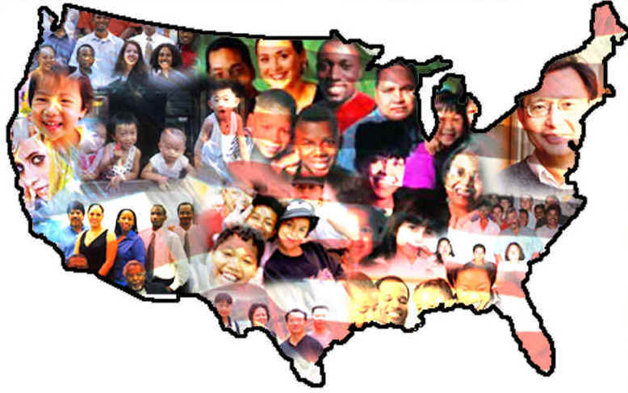
Rights
Enrollment Policies
What Can You Do?
All Children Have the Right to an Education
All children, regardless of immigration status, have the right to attend a K-12 public school in the school district where they live.
School districts may not deny or discourage the enrollment of students based on the immigration status of children or their parents.
This is established law and cannot be changed by the Trump administration or states.
Notes:
Under state and federal law, all children have the right to attend a K-12 public school in the school district where they live, regardless of immigration status. Since this is so important to our discussion today, I’ll repeat that: the law says that all children, regardless of their immigration status, have the right to attend a K-12 public school. Put differently, school districts may not deny or discourage the enrollment of students based on the immigration status of children or their parents.
This is established law and cannot be changed by the Trump administration or states, regardless of their attempts to intimidate and confuse immigrant families about the law.

Slide 4
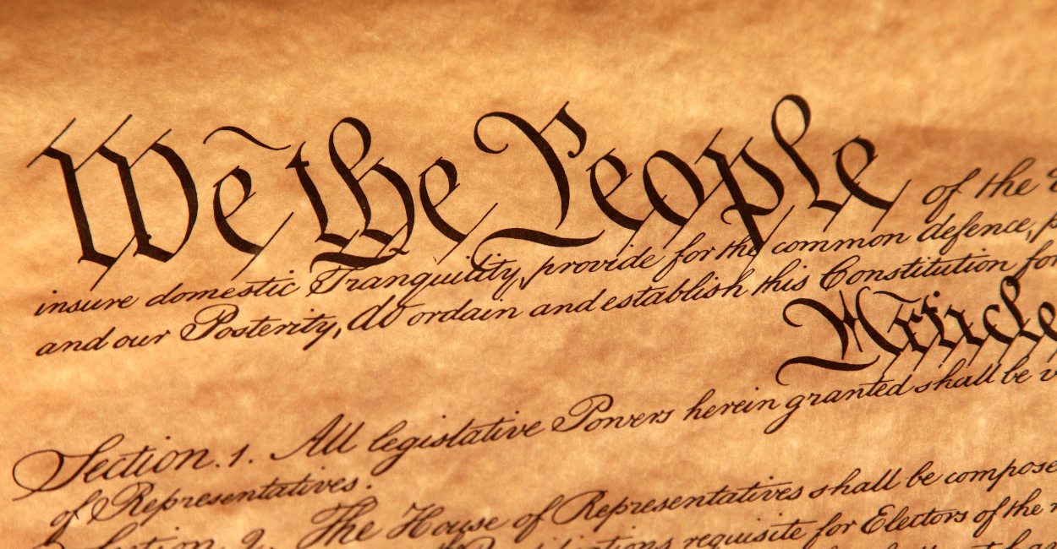
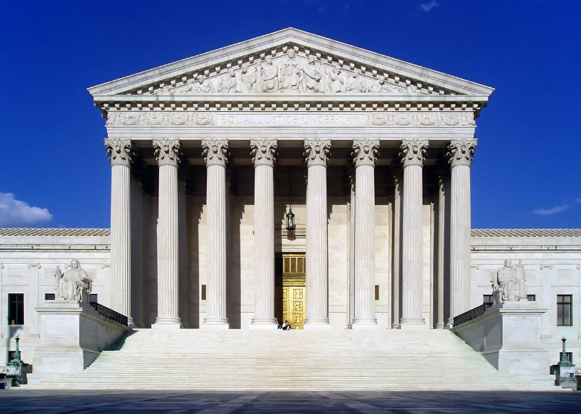
Rights
Enrollment Policies
What Can You Do?
Where Do These Rights Come From?
From the U.S. Supreme Court and the Constitution.
Plyler v. Doe (1982): undocumented students are entitled to the same K-12 education that the state provides to children who are citizens or legal residents.
Notes:
So where do these rights come from?
In 1982, the United States Supreme Court heard a case - called Plyler v. Doe - on a Texas law that allowed the state to withhold funding from any school district that educated undocumented children. The Supreme Court held that this law was unconstitutional and that undocumented students are entitled to the same K-12 education that the state provides to children who are citizens or legal residents.
As a result of this case, the undocumented or non-citizen status of a student – as well as that of their parent or guardian – is irrelevant to that student’s entitlement to access public education. Therefore, the enrollment policies and practices of school districts may not deny or discourage any child from enrolling in school based on citizenship or immigration status.
This has major consequences then for what information and documentation districts may and may not ask for as part of the enrollment process.

Slide 5

Rights
Enrollment
Policies
What Can You Do?
District Enrollment Policies
Districts may not require documentation related to a student’s immigration status during enrollment.
Schools can require some documentation to verify a student’s age and residence.
Generally, schools should be flexible about what types of documents they will accept to enroll a student.
See U.S. Departments of Justice and Education guidance available at: https://www.justice.gov/crt/dear-colleague-letter-rights-all-children-enroll-public-schools]. Your state will also have state-specific laws on enrollment.
Notes:
Given the constitutional right to enroll in public school that was enshrined by the Supreme Court in Plyler v. Doe, school districts may not require documentation related to a student’s immigration status during the enrollment process. Schools can require some documentation to verify a student’s age and residence, which we’ll discuss on the next few slides, but generally, schools should be flexible about what types of documents they will accept to enroll a student.
Districts should also reassess their policies regularly to determine whether they are doing anything that may have the effect, intentional or not, of discouraging the enrollment of undocumented children, such as asking for a social security number or requiring a driver’s license from a parent. Once identified, districts must change any unlawful policies and practices.

Slide 6


Rights
Enrollment Policies
What Can You Do?
Common Issues with Enrollment Policies
Generally, districts cannot require the following documents from children and their parents/guardians:
  Driver’s licenses,
  Birth certificates,
  Proof of citizenship, or
  Social security numbers.
Notes:
So again, schools can require some documentation to verify a student’s age and residence, but they should be flexible about what they will accept. Noncompliance with these rules leads to many of the common issues with district enrollment policies that we’ve seen around the country, specifically that districts cannot require children or their parents or guardians to produce driver’s licenses, birth certificates, proof of citizenship, or social security numbers as part of the enrollment process. Districts cannot require these things.

Slide 7
Rights
Enrollment Policies
What Can You Do?
Common Issues: Proof of Residency
Districts cannot require a parent’s driver’s license or other state-issued photo identification.
To prove residency, parents may provide:
  Copy of a lease,
  Mortgage documents or property deed,
  Utility or other bill (e.g., telephone, water, gas), or
  Driver’s license.
See U.S. Departments of Justice and Education guidance available at: https://www.justice.gov/crt/dear-colleague-letter-rights-all-children-enroll-public-schools]. Your state will also have state-specific laws on enrollment.
Notes:
To provide some greater detail, remember that districts can require proof of residency as part of enrollment. They can not, however, require a parent’s driver’s license or other state-issued photo identification. Instead, districts can allow parents to use a number of other documents to prove residency, including:
a copy of a lease,
mortgage documents or a property deed,
a utility or other bill (such as a telephone, water, or gas bill),
or a driver’s license. Driver’s licenses are acceptable to prove residency, but again, they cannot be required.

Slide 8
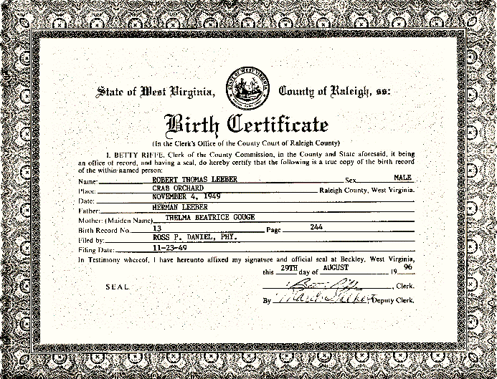
Rights
Enrollment Policies
What Can You Do?
Common Issues: Proof of Age
Districts cannot require a child’s birth certificate.
To prove age, parents may provide:
  U.S. or foreign birth certificate,
  Certificate of baptism,
  Transcript from a prior school showing the child’s date of birth,
  Insurance policy in the child’s life,
  Good-faith Bible record of child’s birth (along with sworn affidavit).
See U.S. Departments of Justice and Education guidance available at: https://www.justice.gov/crt/dear-colleague-letter-rights-all-children-enroll-public-schools]. Your state will also have state-specific laws on enrollment.
Notes:
The same type of situation applies to proving a child’s age. Districts can require proof of age as part of enrollment, but they cannot require a child’s birth certificate. Both U.S. and foreign birth certificates may certainly be used to verify age, but districts must accept alternative documentation to verify this information, such as:
A certificate of baptism,
A transcript from a prior school showing the child’s date of birth,
An insurance policy in the child’s life that has been in effect for at least 2 years, and
A good-faith Bible record of the child’s birth along with a sworn affidavit from a parent or grandparent.

Slide 9
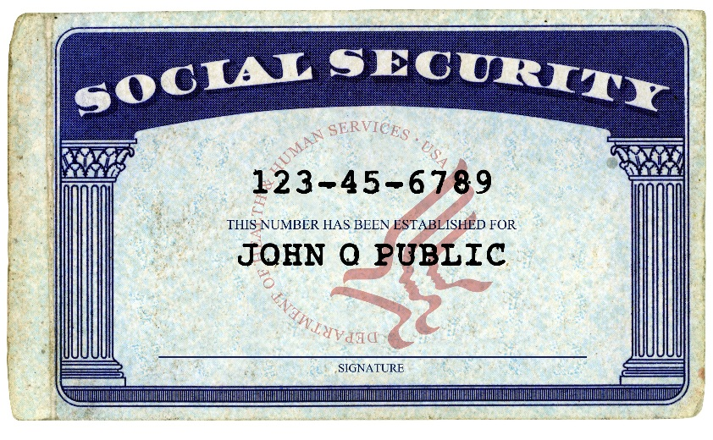
Rights
Enrollment Policies
What Can You Do?
Common Issues: Citizenship and SSN
Proof of citizenship cannot be required at all.
Districts that request a social security number should make it clear that this is voluntary and that choosing not to provide a social security number will not bar a child’s enrollment.
Notes:
Proof of citizenship and social security numbers are also often asked for by districts. However, neither of these documents can be required for enrollment.
Proof of citizenship cannot be required at all, as such a requirement that would violate the Constitution and U.S. Supreme Court.
Social security numbers may be collected, but only for a legally permissible purpose, such as using it as the child’s internal school identification number. Importantly, any district that opts to request a child’s social security number should make it clear that this is voluntary and that choosing not to provide that information will not bar a child’s enrollment.

Slide 10

Rights
Enrollment Policies
What Can You Do?
Common Issues
Other common enrollment issues concern:
  Parents with limited English proficiency,
  Refugee students,
  Homeless students.
Notes:
Finally, other issues we often see with district enrollment policies involve parents with limited English proficiency, refugee students, and homeless students.
For parents with limited English proficiency who seek to enroll a child in public school, districts must “meaningfully communicate material information” about enrollment. They typically satisfy this rule by translating enrollment documents into languages other than English and having some method of responding to parents’ questions in languages beyond English.
The right of all children to attend public school regardless of immigration status also applies to refugee children. These students should be placed in school in accordance with their stated age while embassies and other organizations work to secure appropriate documentation that may be initially unavailable.
Finally, homeless children are exempt from a district’s residency requirements.

Slide 11
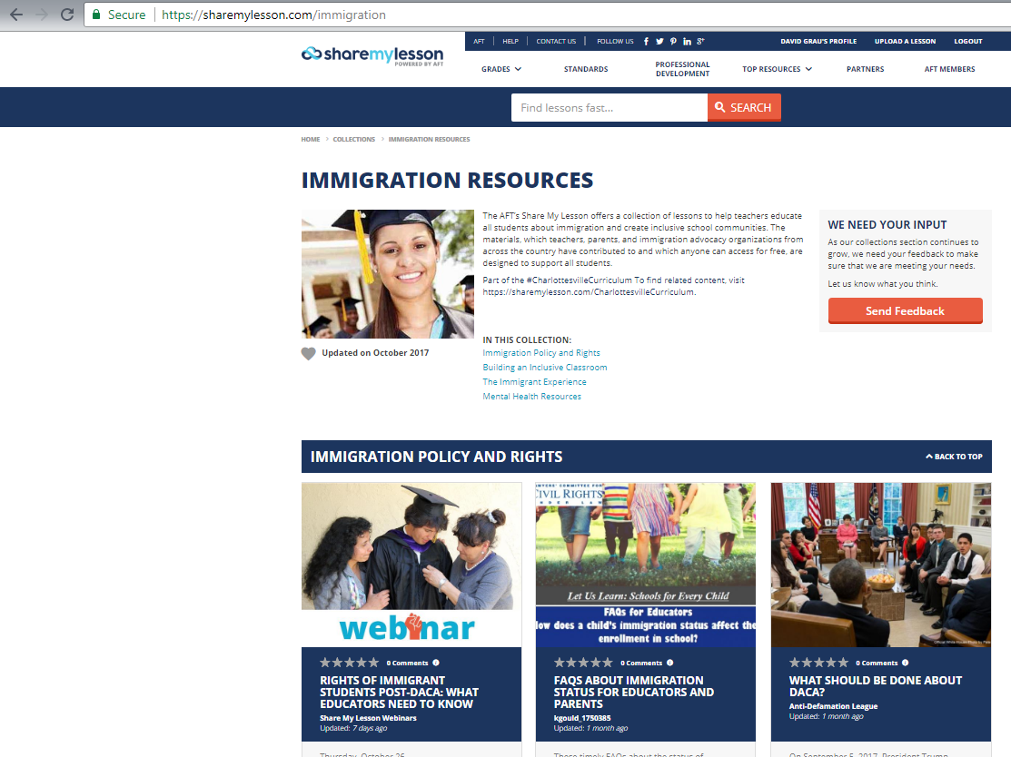
Rights
Enrollment Policies
What Can You Do?
FAQ for Educators and Parents
www.ShareMyLesson.com/Immigration
www.LawyersCommittee.org/LetUsLearn
Notes:
These rules and additional details are summarized in the Lawyers’ Committee’s FAQ about Immigration Status for Educators and Parents on the rights of all children to enroll in school. It can provide another helpful resource if you encounter any challenges and is available on our website – www.LawyersCommittee.org/LetUsLearn – and on the AFT’s ShareMyLesson site in the Immigration Resources collection, the location of which and website are shown here.

Slide 12
Rights
Enrollment Policies
What Can You Do?
What Can You Do?
School, District, and State
Lawyers’ Committee for Civil Rights
AFT
School
District
State
Advocates for Education
Parents & Students
Parents
Students
Notes:
Now, let’s talk about what you can do if you are concerned that your school is denying or discouraging enrollment to students based on immigration status.
There are several ways you can make a difference
By working with parents and students;
Working with people at your school, district, and state;
and working with other advocates for education, such as the AFT or the Lawyers’ Committee.

Slide 13
Rights
Enrollment Policies
What Can You Do?
What Can You Do?
School, District, and State
Lawyers’ Committee for Civil Rights
AFT
School
District
State
Advocates for Education
Parents & Students
Parents
Students
Engage with parents and students so that they are aware of their legal rights.
Share resources, such as our Know Your Rights flyer for parents.
Create a safe space within your classrooms and schools.
Know Your Rights flyer for parents available at
https://sharemylesson.com/teaching-resource/faqs-about-immigration-status-educators-and-parents-290196.
Notes:
First, you can work with the parents and students in your community. You can take the information you learn today and the other resources we have available to engage with parents and students. Help them know their legal rights to enroll in public school. Share our Know Your Rights Flyer for Parents and the other resources we have available online.
Perhaps most importantly, you can also work to create a safe space within your classroom and school for immigrant and undocumented children and families. As an educator, take a stance. Support your vulnerable students by talking with them, sharing resources, and working with your school to help them enroll and stay in school.

Slide 14
Rights
Enrollment Policies
What Can You Do?
What Can You Do?
School, District, and Beyond
State & Federal Gov.
Advocates for Education
Parents & Students
Parents
Students
Lawyers Committee for Civil Rights
School, District, and State
Find your school’s/district’s enrollment policy.
If not in compliance with these rules, discuss that policy with staff.
Call state representatives and local leaders about state enrollment policies.
School
District
State
Notes:
Second, you can get involved at the school, district, and state level. Find your school’s or district’s enrollment policy. These are usually located online and should be available in languages beyond English so that they are accessible and understandable for all. If your district’s policy is not in compliance with these rules, discuss why that is with staff members you know and trust. You can also get involved on the state level by calling state representatives and local leaders to change, affirm, or clarify the existing laws on school enrollment.

Slide 15
Rights
Enrollment Policies
What Can You Do?
What Can You Do?
School, District, and Beyond
State & Federal Gov.
Advocates for Education
Advocates for Children
Parents
Students
Lawyers Committee for Civil Rights
Stay informed about these issues and explore additional resources.
Ask questions about school enrollment or report districts with improper policies and practices through Let Us Let: Schools for Every Child at the Lawyers’ Committee.
Lawyers’ Committee for Civil Rights
AFT
Notes:
If you don’t feel comfortable discussing these matters with your school, district, or state, there are other ways to make a difference. Stay informed about school enrollment and immigration issues. Discuss these issues with other advocates for education, like the AFT or the Lawyers’ Committee.
To protect the right of all children to attend public school regardless of their immigration status, the Lawyers’ Committee for Civil Right Under Law has launched a new initiative called Let Us Learn: Schools for Every Child.

Slide 16


Rights
Enrollment Policies
What Can You Do?
Let Us Learn: Schools for Every Child
Do you have a question about student enrollment policies and the law?
Do you believe a school or district has an improper student enrollment policy or practice?
REPORT IT HERE
www.LawyersCommittee.org/LetUsLearn
Notes:
As part of this project, we’ve sent letters to all 50 state Attorneys General asking them to remind schools and districts of the constitutional rights of immigrant children to attend school. We’ve targeted school districts around the country with noncompliant policies and demanded that they bring their policies and public information in line with the law.
For educators and parents, we’ve launched a new website with resources, like the ones we’ve shared today, about the law on school enrollment. We’ve also created an online form for parents and educators to ask questions about student enrollment and report districts and schools that have noncompliant student enrollment policies and practices securely and anonymously.
Once again, that website is www.LawyersCommittee.org/LetUsLearn and you can go there with any questions you may have about student enrollment or to anonymously report schools or districts that might have illegal student enrollment policies. This is anonymous reporting; if you see something you think is wrong, please come forward so that we can investigate the situation, work with the district to correct their policies, and protect the constitutional right of immigrant and undocumented students to an education.

Slide 17

Questions?
Report a School or District?
www.PREPparents.org
Let Us Learn: Schools for Every Child
www.LawyersCommittee.org/LetUsLearn
Notes:
Thank you all for the opportunity to share this information and our resources with you this evening. Again, if you’re interested in learning more about the rights of immigrant children to attend public school and what documentation districts may ask for during enrollment, I’d encourage you to explore our resources at www.LawyersCommittee.org/LetUsLearn as well as those on general education issues and parent support from our PREP program at www.PREPparents.org.

