Slide 1
PRACTICING FAIR HIRING
What Matters Most to Infinity Service Management

Slide 2
About our Business
Infinity Service Management provides Cleaning and Sanitation Services to Food Manufacturing Plants in the Chicago Area.
Our customers are highly regulated and monitored by the USDA .
Recent events demonstrate the stakes are high when it comes to food safety.
The labor pool of qualified workers in the food plant sanitation industry is shrinking.

Slide 3
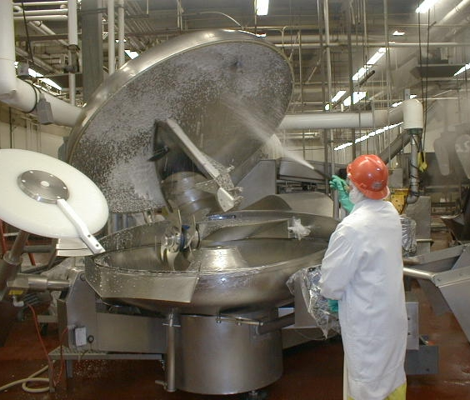
Sanitizing is a complicated process.
Our employees are trained to work on highly specialized food manufacturing equipment.

Slide 4
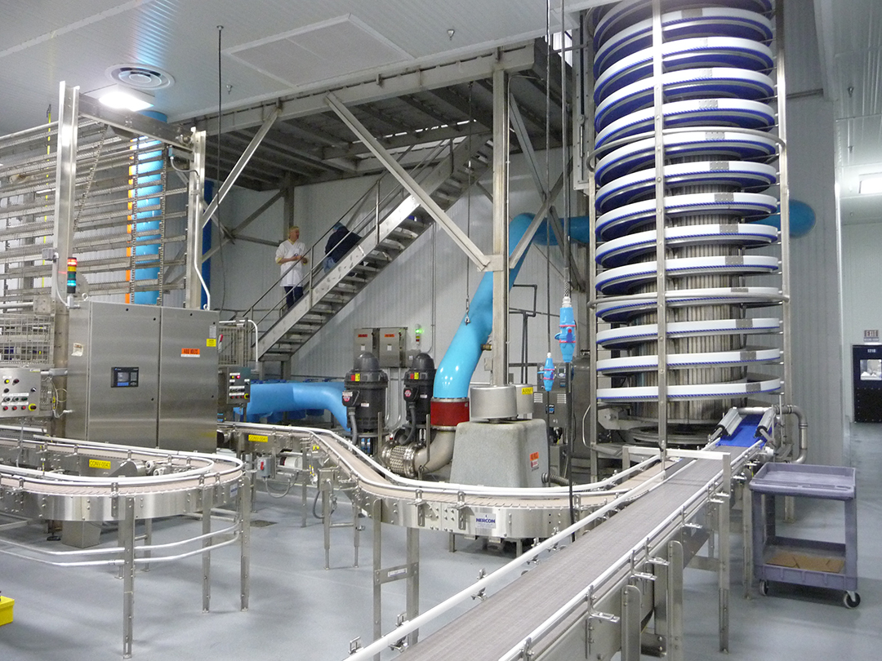
Involves detailed cleaning in highly regulated environment

Slide 5
Hiring Challenges
The nature of our business makes it difficult to attract highly qualified employees.

Slide 6
Why such a Hard Job to Fill?
In the Interview Process, we explain aspects of the job
Extremely hard work
Cold, wet conditions
Hot, steamy environment
Requires standing for long hours
Lots of gear to wear
Requires great attention to detail
Tons of rules & regulations
Work typically done at night
Repetitive actions
Lifting
Disassembling & assembling very expensive equipment
Harsh chemicals
Fast-paced environment
Low wages

Slide 7
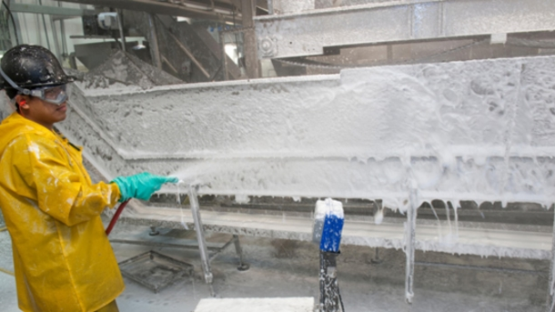
Specialized Cleaning

Slide 8
Hiring Comparisons
How do we approach the hiring process for ex-offenders?

Slide 9
Is There a Difference?
We look for the same qualities from ex-offenders as we do from any other candidate.
A preference is given to those who had a steady work record prior to their incarceration.
A good attitude towards work is important

Slide 10
Applicants with a Record
What is our process? We:
Work closely with Cleve Dixon of the Safer Foundation
Evaluate pertinent information regarding the candidate’s criminal record. Such as,
  Nature of offense
  Record or prior conviction?
  How long ago?
Look at evidence of rehabilitation
Ask new hires to sign a Background Release form..
Utilize the services of TalentWise.

Slide 11
Once an Offer is Accepted
Prepare the new employee and their supervisor to make on-boarding a success.
Dispel any pre-conceived ideas about the new hire
Find out what barriers may be in place for the new hire achieving success

Slide 12
From Candidate to New Hire
Supervisors and managers do not know which new employees have a prior criminal history.
We feel it is important to maintain privacy , however, there are times when some information is shared on a need-to-know basis.

Slide 13
Our Experience in Hiring
Benefits
Roadblocks
Great Attendance
Candidates are Pre-Screened through the Safer Foundation
Not afraid of monotonous work
Typically do not complain about wages
View work in the long term
Employees gain new skills and employment history
Community involvement
Limited mobility and/or flexibility with schedule
Lack of ability to do physical work
Client may prohibit us from assigning someone to their facility
Sometimes afraid to speak up
High percentage leave once they have completed their time at Crossroads ATC

Slide 14
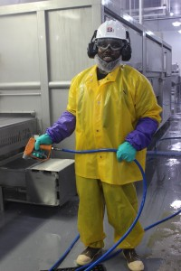
What we offer
A Great Opportunity to Learn New Skills
An Introduction to a Growing Industry
Steady employment
Good opportunities for advancement
A solid way to transition back into society

Slide 15
Conclusion
We maintain open lines of communication with the employee to check on their progress. Also, we hear from former employees on are regular basis. They call to thank us for the opportunity and give us an update on the lives. We are pleased to hear from them and proud of their success.

